Slide 1
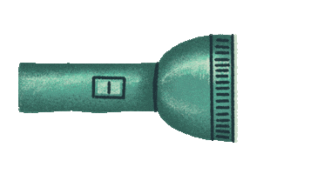
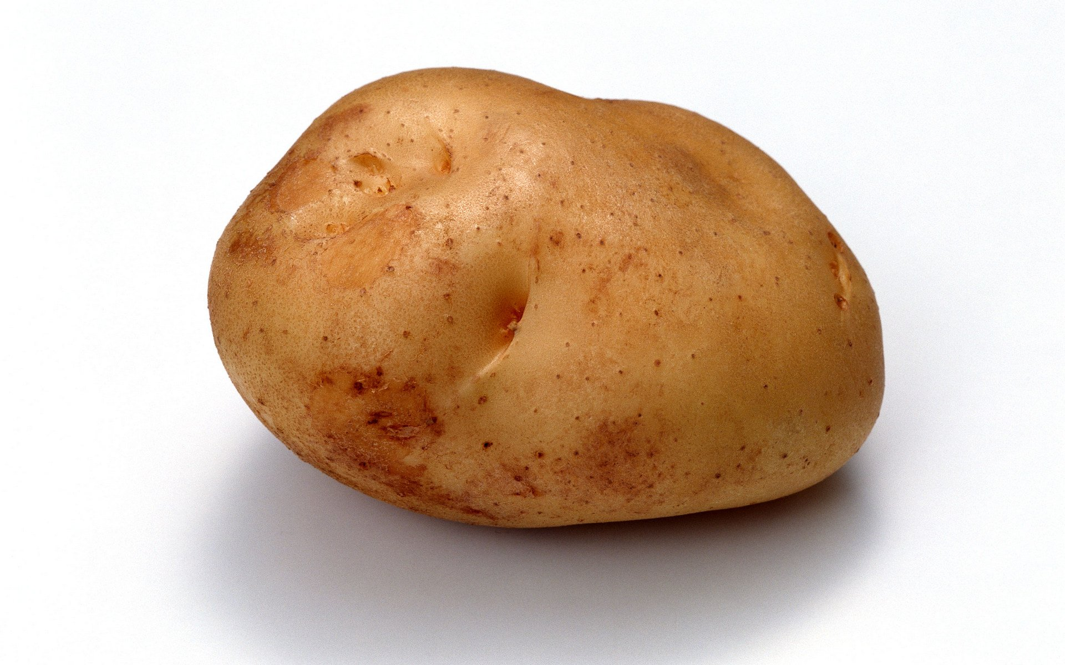
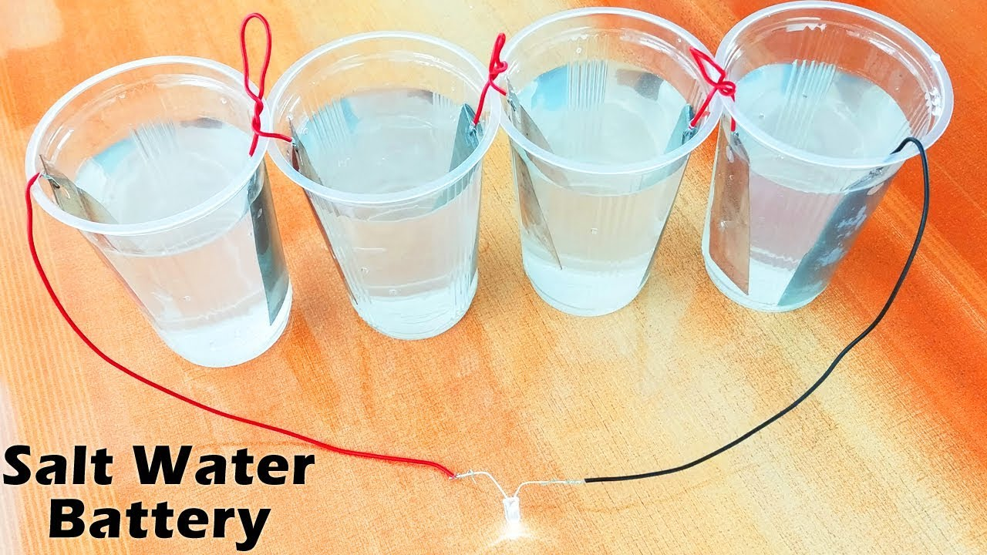
Lit Potatoes(Literally)

Slide 2
Objective
Hands-On Learning Generates a Better Understanding of Electricity
Practical Application Creates Deeper Comprehension
Leaves Questions About The Future of Energy Storage

Slide 3
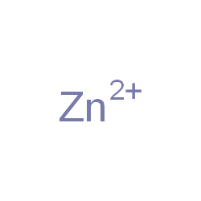
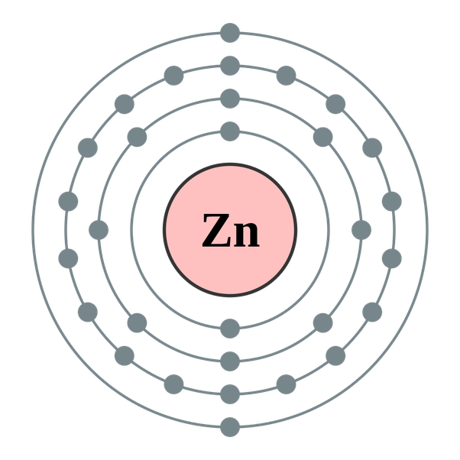
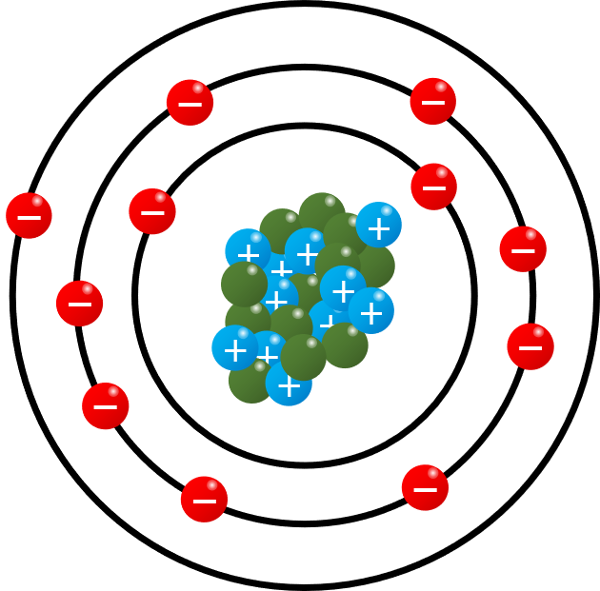
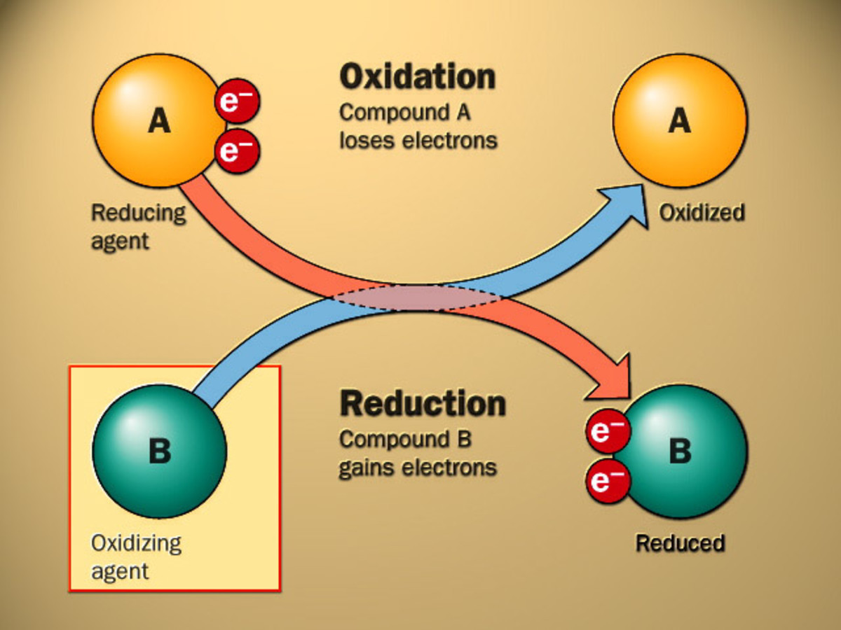
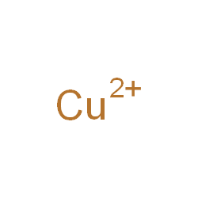
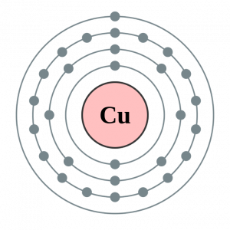
Physics

Slide 4
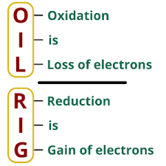
Physics

Slide 5
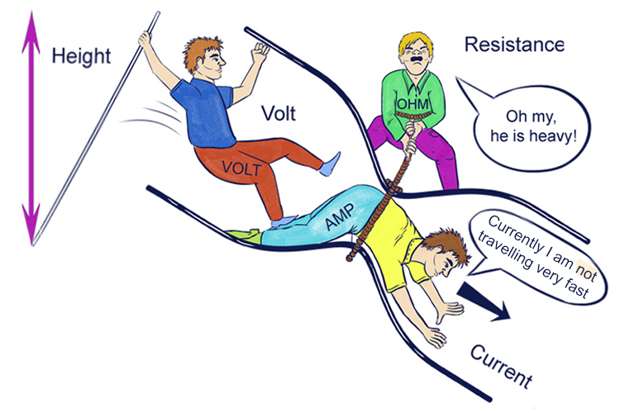
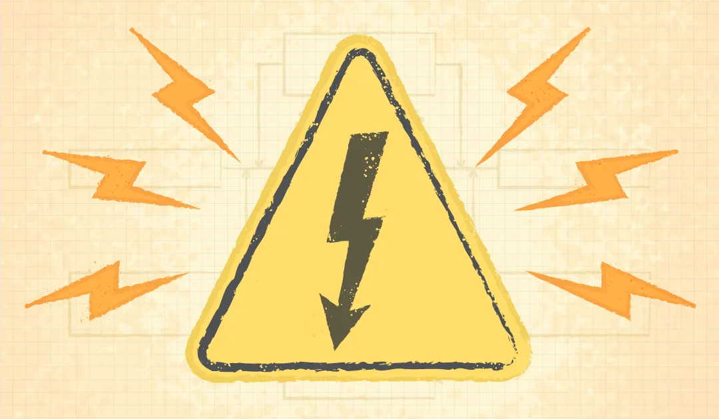
Physics
Voltage, often called "electric pressure," is like the force that pushes electric charges, such as electrons, through a wire or a circuit. It's what makes electricity flow and powers our devices, just like how water pressure moves water through pipes.

Slide 6
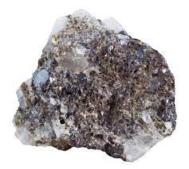

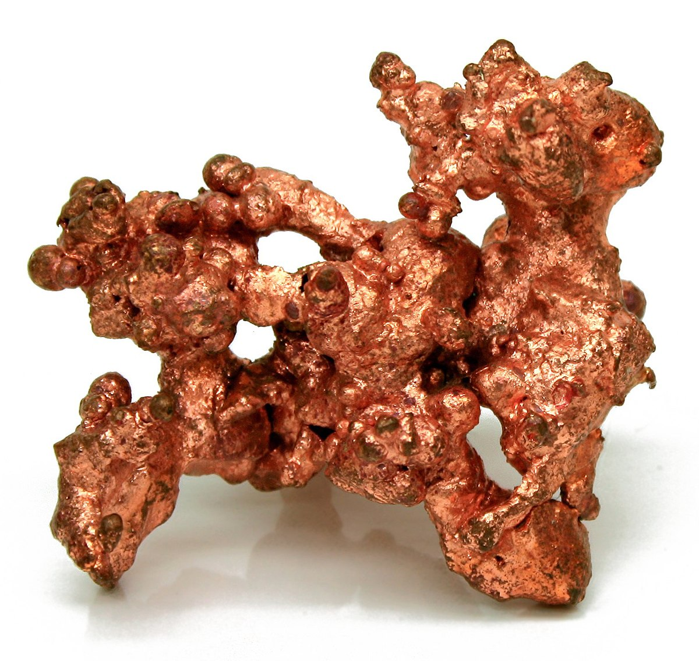
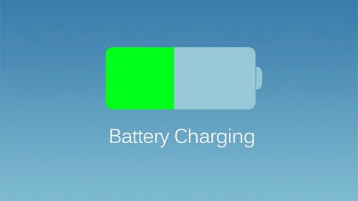
Schematic
v

Slide 7
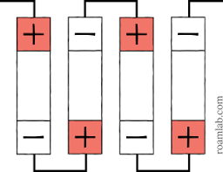
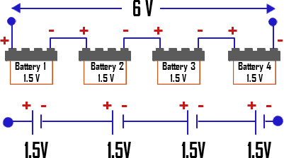
Battery in series
1
1
1
1
Sum =
4!!

Slide 8
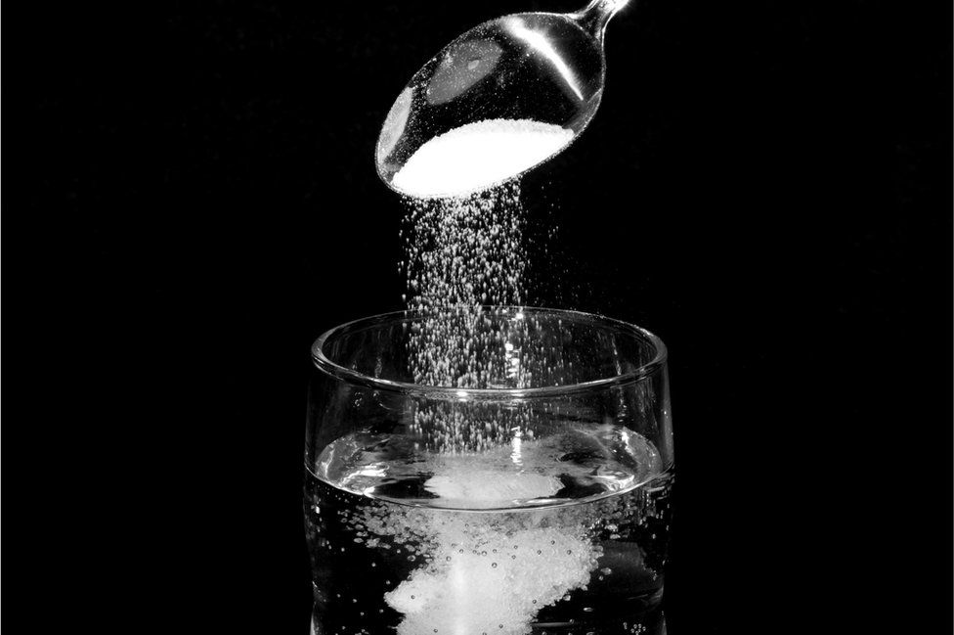
Possible Power Sources?
Potatoes
Saltwater
01
02

Slide 9
The End!
Congratulations on Obtaining a Better Understanding of Electricity!

